Slide 1
Twitter purification
CS246
Jennifer Zhang
Zijun Xue
Wen Shi

Slide 2
Dataset
Twitter
GET statuses/sample
~800 000 tweets
~120 000 distinct words (excluding hashtags, usernames, urls)
Dictionary - Ispell

Slide 3
Single Word Correction
Single word abbreviation
Squeeze
Gathering correction candidates:
Edit distance
Soundex
Metaphone
Filtering using letter similarity
Eliminating duplicates
Scaling via candidate frequency
Dictionary

Slide 4
Phonetic Corrections
How to correct misspelling caused by typing a query that sounds like the target term?
– Example: Hermann and Herman
How to correct misspelling caused by typing a query that sounds like the target term
“phonetic hashing” – similar-sounding terms are hashed to the same value
Algorithms
American Soundex
Metaphone
NYSIIS (New York State Identification and Intelligence System)

Slide 5
Single Word Abbreviations
Manually maintained list of special abbreviations
Potential 1-to-many mapping
fb = facebook
ig = instagram
2 = [to, two, too]
ur = [your, you’re]
Cross-checked most frequent words against dictionary

Slide 6
Squeeze
Squeeze any consecutive triple or more same letters to one or two of them
gooooood will be squeezed to ‘good’ and ‘god’
If more than one consecutive letters, generate all the squeeze combinations as a list.
bammmmmboooooooo
(bambo, bamboo, bammbo, bammboo)
Algorithm
Scan and squeeze

Slide 7
Edit Distance Candidates
Generate a candidate list by enumerating all valid words with in a specific edit distance
graet
Generate : great, greek, graat, graek, grape…
Using a dictionary to check the validity
For graet: only great, greek and grape left
For types of opeations
Deletes
Replaces
Inserts
Transpose

Slide 8
Soundex Algorithm
Idea
Vowels are viewed as interchangeable in transcribing names
Consonants with similar sounds (e.g., D and T) are put in equivalence classes so related names often have the
Algorithm:
Turn every term to be indexed into a four-character:
Example: Hermann ： H655, Herman ： H655, matched!
Example:
Soundex_Dict(“people”): p140
Inverted_Soundex_Dict(p140): [ ‘peaple’, ‘peopleeee’, ‘piebbal’, ‘people', 'peple', 'pupil’,'puffle', 'peoople','peoplle', 'pueblo', 'phaphela', 'pahabol’ ,'people", 'people', 'payable', 'paypal', 'peopleee', 'pablooo', 'papell', 'poeple', 'poweful', 'peopl', 'papal', 'pablo', 'pavel', 'peoiple', 'peoplee', ‘people', 'pebble']

Slide 9
Metaphone Algorithm
Idea
It fundamentally improves on the Soundex algorithm by using information about variations and inconsistencies in English spelling and pronunciation.
Example: “Smith” [ SM0, XMT], “Schmidt” [XMT, SMT]-> both have XMT in common.
Example:
doublemMetaphone_Dict(“people”): [“PPL”, “”]
Inverted_Metaphone_Dict(“people”):[ ‘peaple’, ‘buble’, ‘babble’, ‘peoplle’,‘pablooo’, 'pupil', 'pppl', 'people’, 'papell', 'pebble', 'peopleeee', 'pueblo', 'peoople', 'payable', 'poeple', 'bubbly', 'bubble', 'peoiple', 'bible', 'bpl', 'bubbaloo', 'piebbal', 'peopl', 'peopleee','people', 'bypoll', 'pablo', 'bhopal', 'papal', 'paypal', 'peoplee‘, 'bobble', 'peple’]

Slide 10

Filtering: Viterbi
Dynamic programming algorithm
Finds the most probable path in a hidden Markov model
Used in DNA sequence alignment
Define a matrix V and populate:
Last value is the score of the best path

Slide 11
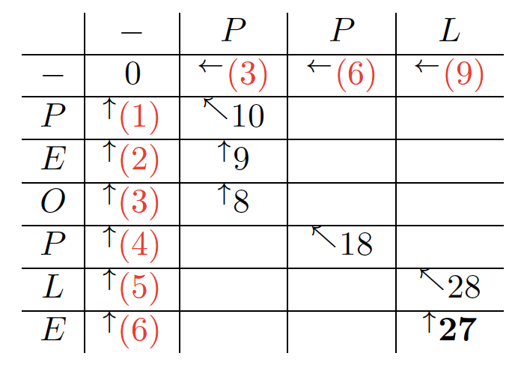

Filtering: Viterbi example
Gap penalties: -3 or -1
Match score: 10
Mismatch score: varying
sim(ppl, people) = 27/30
Filter out low similarity
Multiply by sim

Slide 12


Final Correction Candidates
Scale by ln(frequency) of the candidate where w is the original word and c is the candidate
If w exists in dictionary, add to list of candidates with maximum score
Remove any duplicate candidates, keeping the entry with the maximum score
Trim list to candidates within 70% of maximum score

Slide 13
Word Correction Evaluation
List of most frequent non-dictionary words
Manually mapped 378 to probable correction(s)
Record error if the candidate correction list has no overlap with probable corrections
Results: 80 errors
tryna, kd, thot, cuz

Slide 14
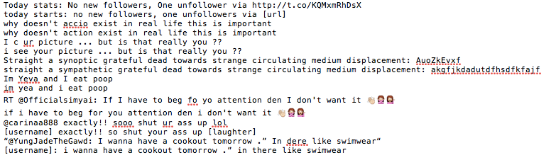
Text Correction Example
Replacements:
“@user” —> [username]
“#hashtag” —> [hashtag]
“http(s)://…” —> [url]
Using single word correction and phrase

Slide 15
Bigram Correction
Semantic check through bigram correction
a ‘good’ boy or a ‘god’ boy
Idea
Check the frequency of each bigram in the whole corpus
Check the semantic error
Algorithm
Build the bigram frequency dictionary
Correct bigram based on the words correction score and bigram frequency

Slide 16
Bigram correction
Example
(a) (good, god) (boy, buy)
(good, boy) 100
(good, buy) 5
(god, boy) 1
(god, buy) 1
The final result is “a good boy”

Slide 17
Issues
Proper names and acronyms, e.g. Cersei
Unusual words, e.g. accio
Metadata lost and/or unconsidered: capitalization, emoji, hashtags
Ambiguous abbreviations, e.g. kd
Abbreviations for multiple words, e.g. tryna
Aesthetically split words, e.g. P R E T T Y
Slang, e.g. thot
Candidate generation refinement

